Slide 1
Potential and Kinetic Energy
Year 10 Physics

Slide 2
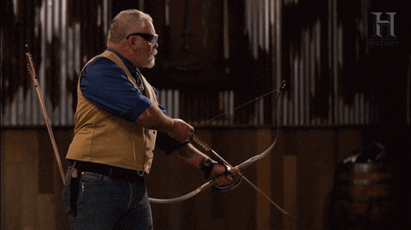
Learning Objectives
CFU
What are we going to learn?
Describe factors affecting potential and kinetic energy.
Explain the energy changes in falling objects.
Activate Prior Knowledge
Energy can be classified into two main forms:
Potential energy is energy stored in objects, for example a drawn bow.
Kinetic energy is the energy in moving objects, for example the arrow moving through the air after it is released.
Think, Pair, Share: What is another example of potential (stored) energy being turned into kinetic (moving) energy?

Slide 3
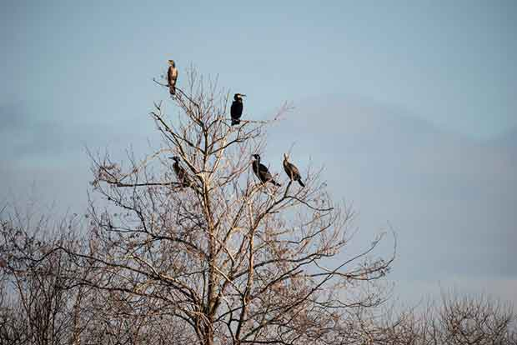

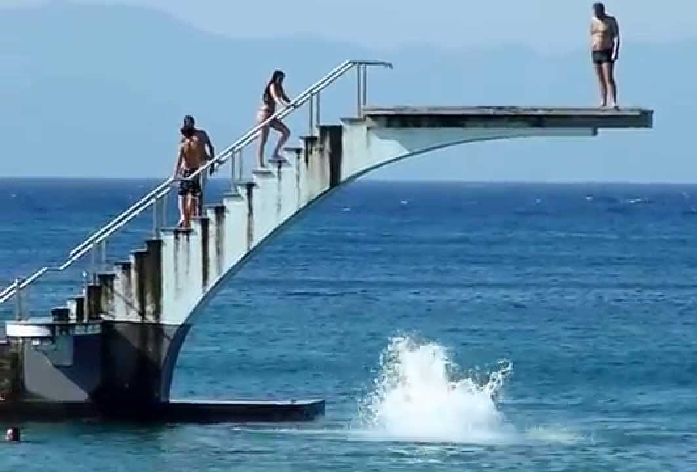
Concept Development
CFU 1
What is the definition of gravitational potential energy?
Gravitational Potential Energy (GPE)
Gravitational potential energy (GPE) is energy stored in objects above the Earth’s surface.
A diver on a diving board, a bird on the branch of a tree and a flying plane all possess gravitational potential energy.
CFU 2
Which of the following have GPE? Give a reason for your choice. A basket ball rolling across the ground A skydiver jumping out of a plane Your pencil case sitting on your desk.

Slide 4
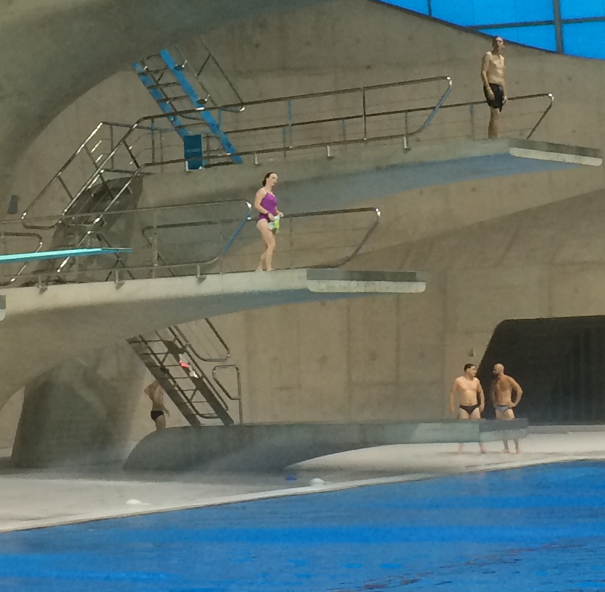
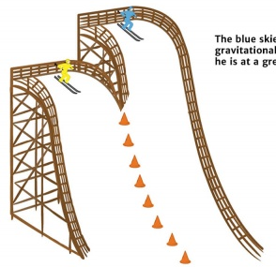
Concept Development
Reminder:
Gravitational potential energy is energy stored in objects above the Earth’s surface
CFU 1
What is the relationship between height and the amount of GPE?
Factors Affecting GPE
As an object is raised higher above the Earth’s surface, it gains more potential energy.
For example, the blue skier has more potential energy than the yellow skier, since they are higher up the slope.
CFU 2
Which person in the image will have the least GPE? Explain why.
CFU 3
Which person in the image will have the most GPE? Explain why.

Slide 5
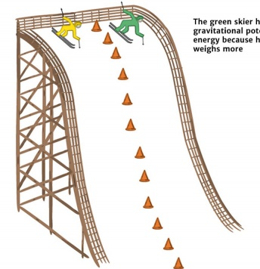
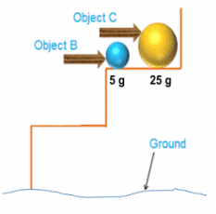
Concept Development
Reminder:
Gravitational potential energy is energy stored in objects above the Earth’s surface
CFU 1
What is the relationship between GPE and the mass of objects?
Factors Affecting GPE
Gravitational potential energy depends on an object's mass.
An object with a large mass has more GPE than an object with a small mass.
For example, the yellow ball has more GPE than the blue ball because it has more mass and they are the same distance from the ground.
CFU 2
Which person in the image will have the least GPE? Explain why.
70 kg
90 kg
CFU 3
Which person in the image will have the most GPE? Explain why.

Slide 6
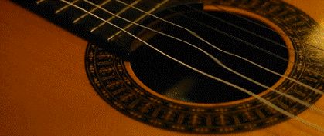

Concept Development
CFU 1
What is kinetic energy?
Kinetic Energy (KE)
Kinetic energy (KE) is the energy possessed by moving objects.
A person running, a flying plane and vibrating guitar strings all possess kinetic energy.
CFU 2
Which of the following have KE? Give a reason for your choice. A basket ball rolling across the ground A skydiver jumping out of a plane Your pencil case sitting on your desk.

Slide 7
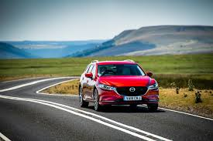
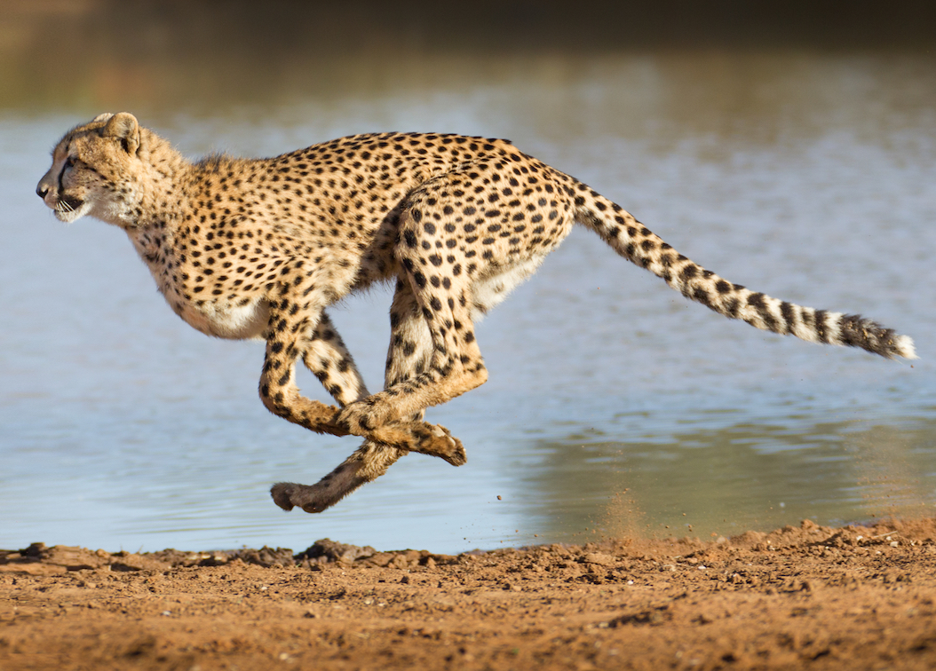
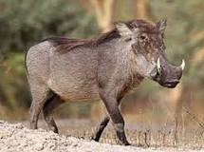
Concept Development
Reminder:
Kinetic energy is the energy possessed by moving objects
CFU 1
What is the relationship between kinetic energy and velocity?
Factors Affecting KE
The amount of kinetic energy an object possesses is determined by the velocity of the object.
Objects traveling at a higher velocity have more kinetic energy.
For example, a car moving at 60 km/h has more kinetic energy than a car moving at 40 km/h.
CFU 2
When moving at their top speed, which would have more kinetic energy: a cheetah or a warthog? Explain why.

Slide 8

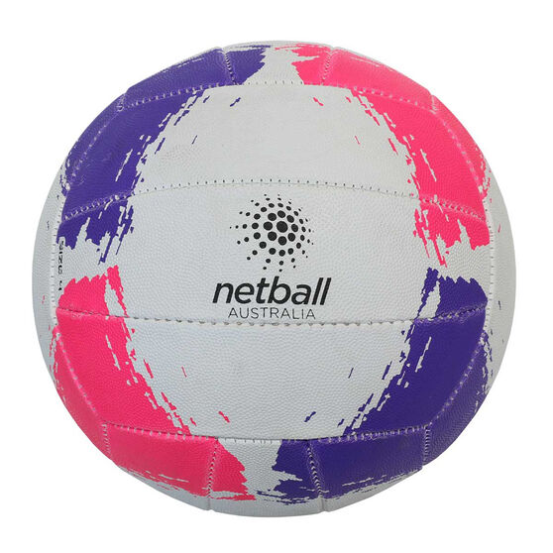
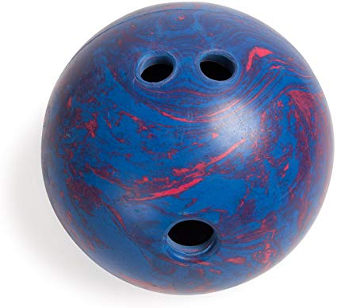
Concept Development
Reminder:
Kinetic energy is the energy possessed by moving objects
CFU 1
What is the relationship between kinetic energy and an object’s mass?
Factors Affecting KE
The amount of kinetic energy an object possesses is also determined by the mass of the object.
Objects with a larger mass have more kinetic energy.
For example, if a netball and a bowling ball are rolled along the ground at the same velocity, the bowling ball possesses more kinetic energy as it has a larger mass.
CFU 2
The car and the truck are moving at the same velocity. Which one has less kinetic energy? Explain your choice.

Slide 9
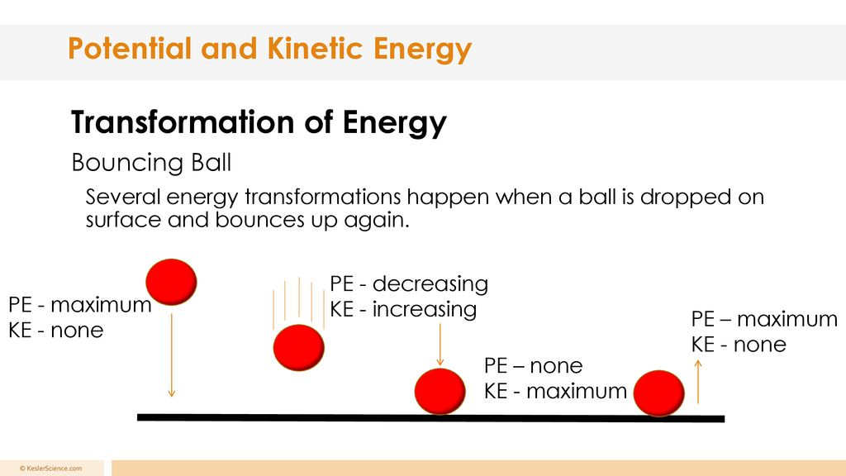
Concept Development
Reminder: Law of Conservation of Energy
Energy cannot be created or destroyed, only transferred or transformed.
CFU 1
When does the object have its maximum GPE?
Energy Changes in Falling Objects
When an object is held at a height off the ground, it has its maximum gravitational potential energy.
As it falls and loses height, it also loses some of its gravitational potential energy.
This energy is transformed into kinetic energy in the moving object.
When the object reaches the ground all of its gravitational potential energy has been transformed into kinetic energy.
CFU 2
What happens to the GPE as the object falls?
CFU 3
When the object hits the ground, describe its KE and GPE.

Slide 10
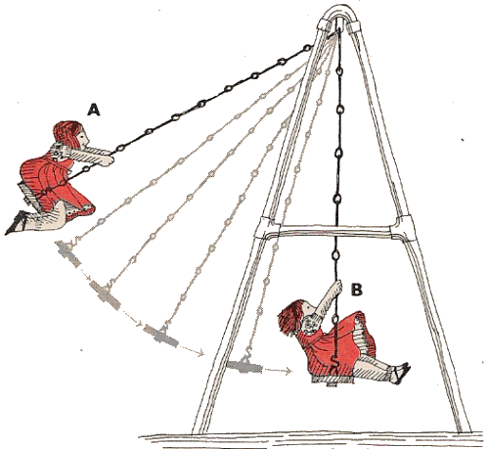
Skill Development/Guided Practice
Energy changes can be represented using flow diagrams to show how the energy of the object is being transformed.
Draw a flow diagram to show the energy changes in the diagram of the girl on the swing.
At position A, she has maximum GPE and zero KE
At position B, she has minimum GPE and maximum KE

Slide 11
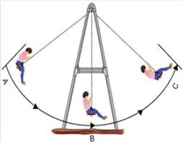
Skill Development/Guided Practice
Draw a flow diagram to show the energy changes in the diagram of the girl on the swing.
At position A, she has maximum GPE and zero KE
At position B, she has minimum GPE and maximum KE
At position C, she has maximum GPE and zero KE

Slide 12
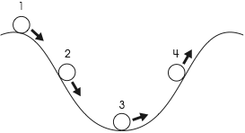
Skill Development/Guided Practice
Draw a flow diagram to show the energy changes in the diagram of the ball rolling down a hill into a ditch.
At position 1, the ball has maximum GPE and zero KE
At position 2, the ball has decreasing GPE
and increasing KE
At position 3, the ball has minimum GPE and maximum KE
At position 4, the ball has minimum both GPE and KE

Slide 13
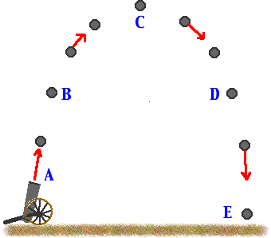
Skill Development/Guided Practice
Draw a flow diagram to show the energy changes in the diagram of the cannon ball being fired out of a cannon.
At position A, the ball has low GPE and maximum KE
At position B, the ball has increasing GPE and decreasing KE
At position C, the ball has maximum GPE and zero KE
At position D, the ball has decreasing GPE
and increasing KE
At position E, the ball has zero GPE and maximum KE

Slide 14
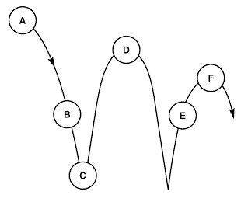
Skill Development/Guided Practice
Draw a flow diagram to show the energy changes in the diagram of the ball bouncing.
At position A, the ball has maximum GPE and zero KE
At position B, the ball has decreasing GPE and increasing KE
At position C, the ball has minimum GPE and maximum KE
At position D, the ball has zero KE and high GPE, but less than it had at A
At position E, the ball has increasing GPE and decreasing KE
At position F, the ball has zero KE and high GPE, but less than it had at A and D

Slide 15

Relevance
Understanding the relationship between gravitational potential energy and kinetic energy will help you explain energy transformations in falling objects.
It will also help you explain why the velocity of objects increases as they fall or roll down a hill, as they lose gravitational potential energy and gain kinetic energy.

Slide 16
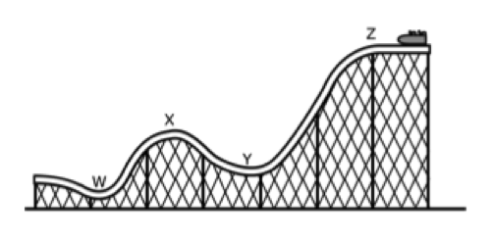
Skill Closure
Explain the difference between kinetic energy and gravitational potential energy.
Skill Closure
What are two factors that affect the gravitational potential energy in an object and how do the affect it?
Skill Closure
Describe the energy changes in the rollercoaster using a flow diagram.

Slide 17
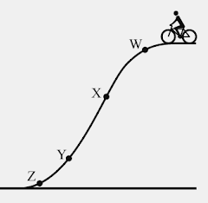
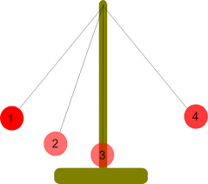
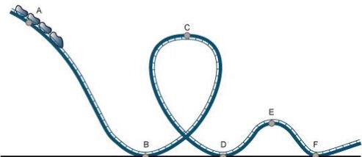
Independent Practice
Answer the following questions in your science book or on your device.
Explain the difference between gravitational potential energy and kinetic energy.
Draw a Venn diagram with headings: Kinetic Energy, Gravitational Potential Energy, Both
Place the following examples in the correct section of the Venn diagram.
    A diver on a high diving board A ball rolling along the ground An apple on a tree
    A ball thrown through the air A car driving on a flat road
Describe, with examples, two factors that affect the GPE of an object.
Describe, with examples, two factors that affect the KE of an object.
Assuming that the cyclist does not apply brakes as he goes down the hill,
  At which point will his GPE be the lowest? Explain your choice.
  At which point will his KE be closest to zero? Explain your choice.
  At which point will his KE and GPE be approximately equal? Explain your choice.
Draw flow diagrams to show the energy changes in the three diagrams.

